Slide 1
TellCo Data Analysis & Recommendations
A Comprehensive Analysis of User Behavior, Engagement, Experience, and Satisfaction
Darshika Dudhat
27 Jan, 2025

Slide 2
Objective
Analyze TellCo’s data & provide actionable insights for business growth potential.
Understand customer needs and network performance
Drive data-informed decision-making for business expansion.
Key Deliverables:
Analyze data to uncover trends in user behavior, engagement, and network performance.
Recommend strategies to enhance customer satisfaction and drive business growth.

Slide 3
Task 1 - User Overview Analysis
Interpretation (Task 1.1):
Huawei leads as the most popular handset brand among users.
Apple holds a strong position with multiple models in the top 10, including the iPhone 6S and iPhone 6.
Samsung Galaxy S8 emerges as a key competitor in user preference.
Recommandation:
Prioritize offers for Huawei and Apple users, focus on Samsung-specific benefits to boost engagement, and run campaigns encouraging unidentified handset users to register their devices.

Slide 4
Data Correlations (Task 1.2):
Gaming data correlates (0.998) with total usage, making it a major contributor.
Platforms like YouTube and Netflix show minimal correlation (<0.03).
Email uploads have negligible and negative correlation (-0.0016).
User Decile insight:
Deciles 0, 3, and 4 exhibit high data usage due to longer sessions or frequent high-data activities.
Decile 2 (average sessions) shows significantly lower usage (~6.08 TB).
PCA highlights:
PC1 captures throughput patterns, distinguishing low vs. high download rates.
PC2 reflects HTTP traffic and intermediate downloads, indicating correlated behaviors.

Slide 5
Task 2 - User Engagement Analysis
Cluster Characteristics:
Cluster 0 (Low Engagement): Occasional users with low session counts and traffic.
Cluster 1 (Medium Engagement): Regular users with moderate session counts and traffic.
Cluster 2 (High Engagement): Heavy users with high session counts and traffic.
Insights:
Marketing Strategy: Tailor promotions to user engagement levels.
Resource Optimization: Allocate network resources efficiently.
Customer Retention: Engage low-usage customers to prevent churn.

Slide 6
Decision Making:
High Engagement Cluster: Offer premium services or loyalty rewards.
Medium Engagement Cluster: Target with promotional campaigns.
Low Engagement Cluster: Address churn risks with re-engagement offers.
Recommendations Based on Findings:
High Data Consumers (e.g., Cluster 6):Offer premium plans and additional services (e.g., high-speed data).
Moderate Users (e.g., Cluster 3):Provide incentives such as loyalty programs to increase engagement.
Low Usage Customers (e.g., Cluster 0):Encourage data usage with promotions or bundled services.

Slide 7
Task 3 - Experience Analytics
Boxplot Insights:
Downlink Throughput: Higher median = better performance; wider IQR = more variability.
TCP Retransmissions: Higher retransmissions = connectivity issues; lower = stable performance.
Cluster Insights:
Cluster 0 (High-Performance):
Low retransmissions, low RTT, high throughput.
Recommendation: Offer premium data plans and high-speed services.
Cluster 1 (Moderate-Performance):
Moderate retransmissions and RTT, moderate throughput.
Recommendation: Provide optimization solutions during peak times

Slide 8
Cluster Insights (Continued):
Cluster 2 (Low-Performance):
High retransmissions, high RTT, low throughput.
Recommendation: Suggest network troubleshooting, device upgrades, or better coverage.
Recommendations:
Cluster 0: Maximize experience with premium services.
Cluster 1: Enhance performance during peak times.
Cluster 2: Address connectivity issues with troubleshooting or upgrades.

Slide 9
Task 4 - Satisfaction Analysis
Task 4.1:
Engagement Score: Calculated as the Euclidean distance between each user's data point and the least engaged cluster from Task 2.
Experience Score: Calculated as the Euclidean distance between each user's data point and the worst experience cluster from Task 3.
Task 4.2:
Satisfaction Score: Average of the Engagement and Experience scores for each user.

Slide 10
Top 10 Satisfied Customers:
MSISDN: 3.369858e+10, Satisfaction Score: 1.221813e+09
MSISDN: 3.366131e+10, Satisfaction Score: 1.226956e+09
MSISDN: 3.366491e+10, Satisfaction Score: 1.227758e+09, And so on.
Satisfaction Score Summary:
Count: 106,857
Mean: 2.46e+09
Standard Deviation: 3.62e+07
Range: 1.22e+09 (min) to 2.47e+09 (max)

Slide 11
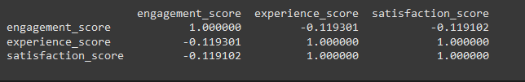
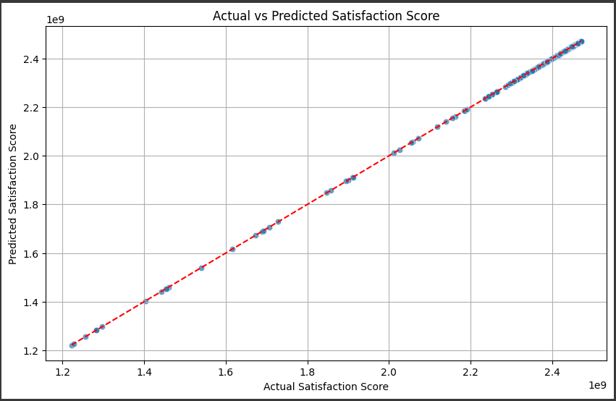
Predicted Satisfaction:
Regressor model gives best fit for the data.Here’s the outcome for it.

Slide 12
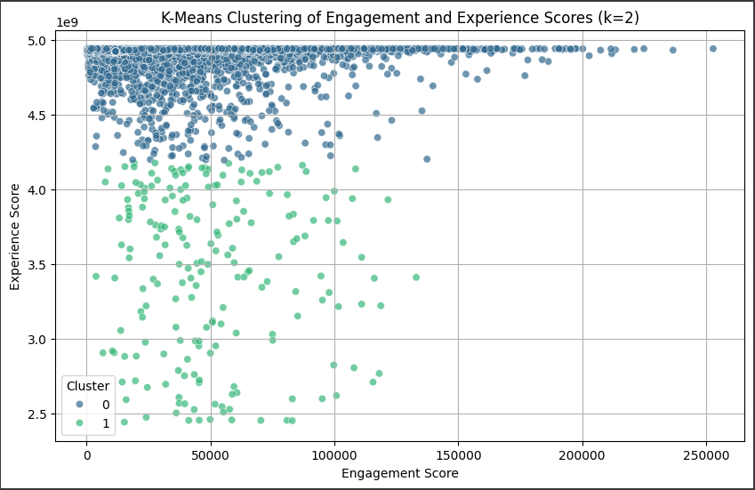
Clustering Satisfaction and Experience:
Cluster 0 provides more engagement and experience compare to cluster 1.

Slide 13
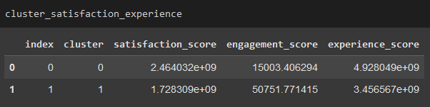
Aggregate Scores per Cluster:
Conclusion:
Cluster 0:
These users are likely casual users who enjoy a seamless experience and remain satisfied with service.
Cluster 1:
These users are power users who frequently interact but are less satisfied due to possible networ/device issues.

Slide 14
Limitations
The analysis is limited by potential data quality issues, such as missing values and outliers, which could affect the accuracy of results.
It assumes linear relationships in the regression model and equal importance of metrics like engagement and experience, which may not reflect real-world complexity.
Additionally, the clustering relies on K-Means, which assumes equal-sized clusters, potentially oversimplifying the user segmentation.
The dataset provides a static snapshot, lacking insights into temporal trends or seasonality.
Finally, external factors like market competition and regional variations were not considered, limiting the generalizability of findings.

Slide 15
Final Recommendation
Recommendation: Purchase TellCo.
Justification:
Loyal and engaged user base.
Reliable network infrastructure minimizes the need for immediate upgrades.
High satisfaction indicates a strong position to retain and expand the customer base.
Recommendation: Conditional Purchase.
Justification:
Require TellCo to implement specific improvements before acquisition or negotiate a lower price to account for future investments.

Slide 16
Recommendation: Do Not Purchase TellCo.
Justification:
Acquiring TellCo would require significant investment to improve services.
Low user satisfaction suggests a weak brand or significant operational issues.

Slide 17
Recommendation on TellCo Acquisition
Executive Summary: Based on the analysis of TellCo's engagement, experience, and satisfaction metrics, as well as its operational and market performance, the recommendation is as follows:
Key Findings:
Engagement:
High/Moderate/Low user activity (session frequency, traffic).
Experience:
Strong/Weak network performance (e.g., RTT, throughput).
Satisfaction:
High/Low satisfaction across clusters.
Final Recommendation:
Based on the above findings, we recommend:
Conditional Purchase TellCo.

